Slide 1
WWW Technology Final Project
Hyeonsu KIM
Student number : A23785

Slide 2
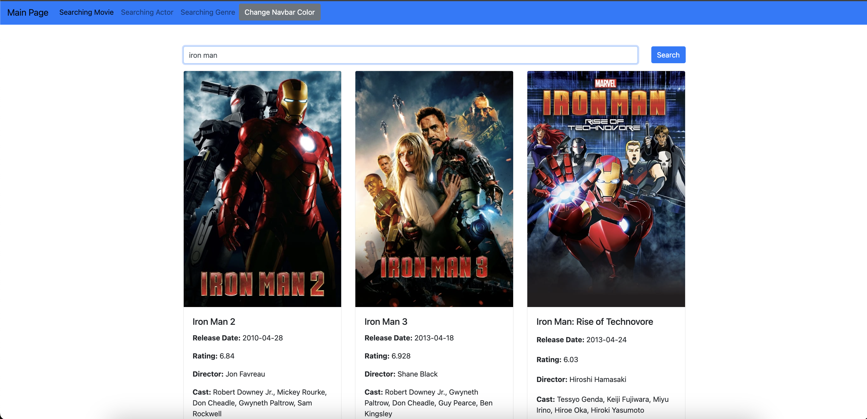
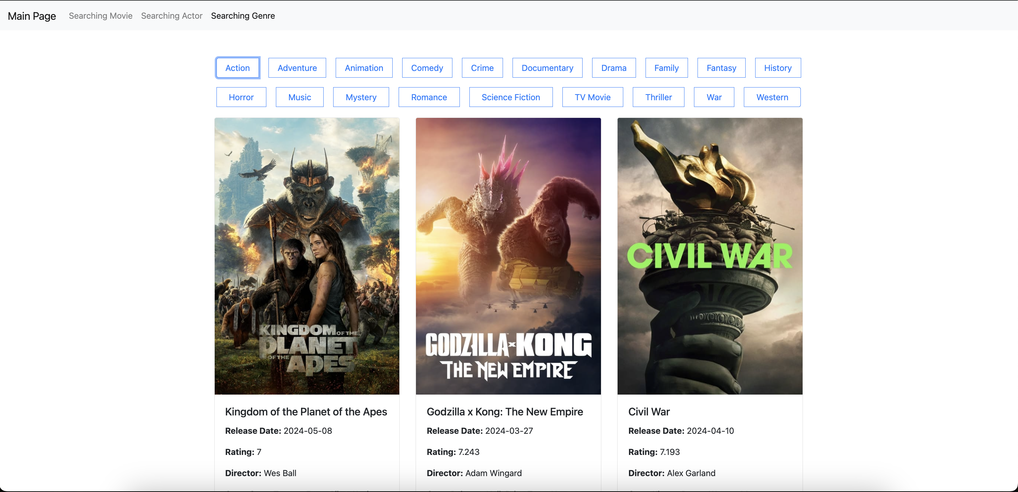
Project Annotation
Movie Searching Website
Notes:
This website is a platform that enables users to search for movies using the TMDB API. It was developed with the intent of streamlining the process of finding detailed information about movies, addressing the inconvenience of manually searching for such details on traditional search engines like Google.

Slide 3
Description of the main functionality
Navigation Bar: A user-friendly navigation bar that allows for easy access to various sections of the site, including 'Home', 'Movie Search', 'Actor Search', and 'Genre Search’.
Movie Search Functionality: The homepage prominently features a search box where users can input movie titles. Upon submitting their search, users can quickly obtain relevant information about the movies they're interested in.
Search Results Display: The results from the user's search query are displayed in a clear and organized manner, making it easy for users to find the information they are looking for without having to sift through unnecessary data.
4. Pagination: For searches that return a large number of results, a pagination feature is provided to help users navigate through the information in a more manageable way, allowing them to view the results across multiple pages.

Slide 4
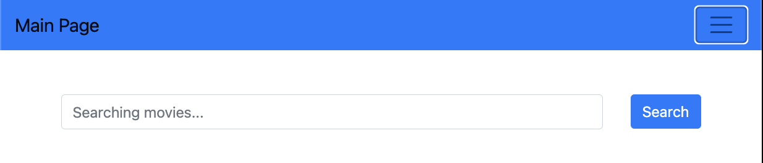
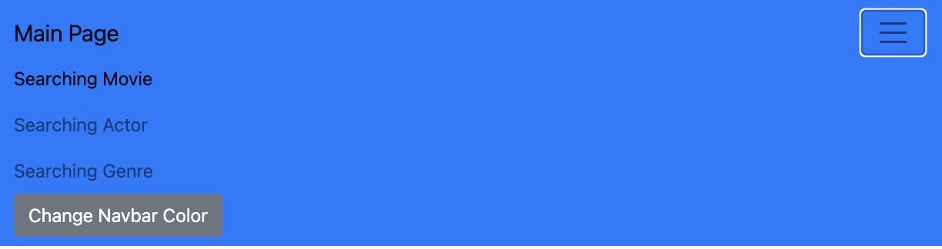
Technologies (HTML)
This HTML code uses the following libraries:
1. **Bootstrap**: Used for designing the website and ensuring responsive layouts. It includes both Bootstrap's CSS and JS libraries.
- CSS Link: https://stackpath.bootstrapcdn.com/bootstrap/4.5.2/css/bootstrap.min.css
- JS Links:
- jQuery: https://code.jquery.com/jquery-3.5.1.slim.min.js
- Popper.js: https://cdn.jsdelivr.net/npm/@popperjs/core@2.5.2/dist/umd/popper.min.js
- Bootstrap JS: https://stackpath.bootstrapcdn.com/bootstrap/4.5.2/js/bootstrap.min.js
2. **jQuery**: Utilized for operating Bootstrap's JavaScript plugins. jQuery is a lightweight JavaScript library that simplifies DOM manipulation.
3. **Popper.js**: A library that allows more flexible positioning of popup elements like tooltips and popovers. It's necessary for using tooltip and popover features in Bootstrap.

Slide 5
Technologies (JavaScript)
1. **JavaScript (ES6/ES2015 and beyond)**
Syntax and features from ES6 onwards like variable declarations with `let`, `const`, template literals, arrow functions (`=>`), and Promises have been used.
2. **DOM Manipulation**
DOM APIs such as `document.getElementById`, `addEventListener`, `createElement`, `innerHTML`, etc., are used to manipulate elements in the HTML document and respond to user interactions by adding event listeners.
3. **Fetch API**
The `fetch` function, part of the Fetch API, has been used to asynchronously retrieve data from web APIs. This provides the functionality to send and receive network requests.

Slide 6
Technologies (JavaScript)
4. **The Movie Database (TMDb) API**
The Movie Database (TMDb) API has been utilized to search for and retrieve movie data. This is done using the `fetch` function to make calls, and it's used for searching information on movies or actors.
5. **Pagination**
Pagination logic has been implemented to divide the searched movie list into pages. This helps manage the amount of data users want to view and improves user experience.
6. **Asynchronous Programming**
Asynchronous data handling is achieved by using Promises and the `then()` method. This allows for performing additional tasks with the data received from the server after fetching it.
7. **localStorage**
Part of the Web Storage API, localStorage is an object that allows storing data in the browser as key-value pairs. `localStorage.getItem('navbarColor')` retrieves the value (color) stored with the key 'navbarColor'. If a value exists, it applies the color previously set by the user to the navigation bar. `localStorage.setItem('navbarColor', newColor)` stores the new color chosen by the user with the key 'navbarColor'.
Notes:
I was able to load many movies at once with asynchronous programming.
Using local storage, I could set up a theme suitable for the user.

Slide 7
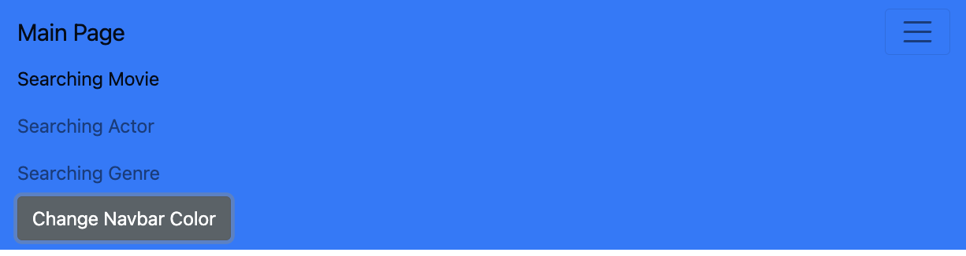
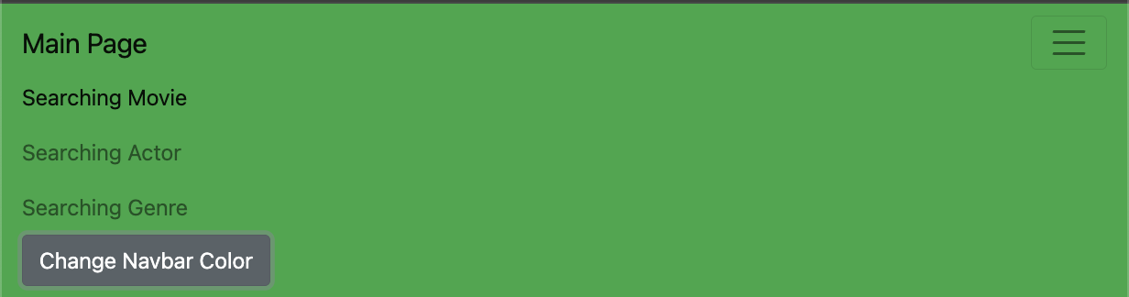
Technologies (JavaScript)
*local Storage

Slide 8
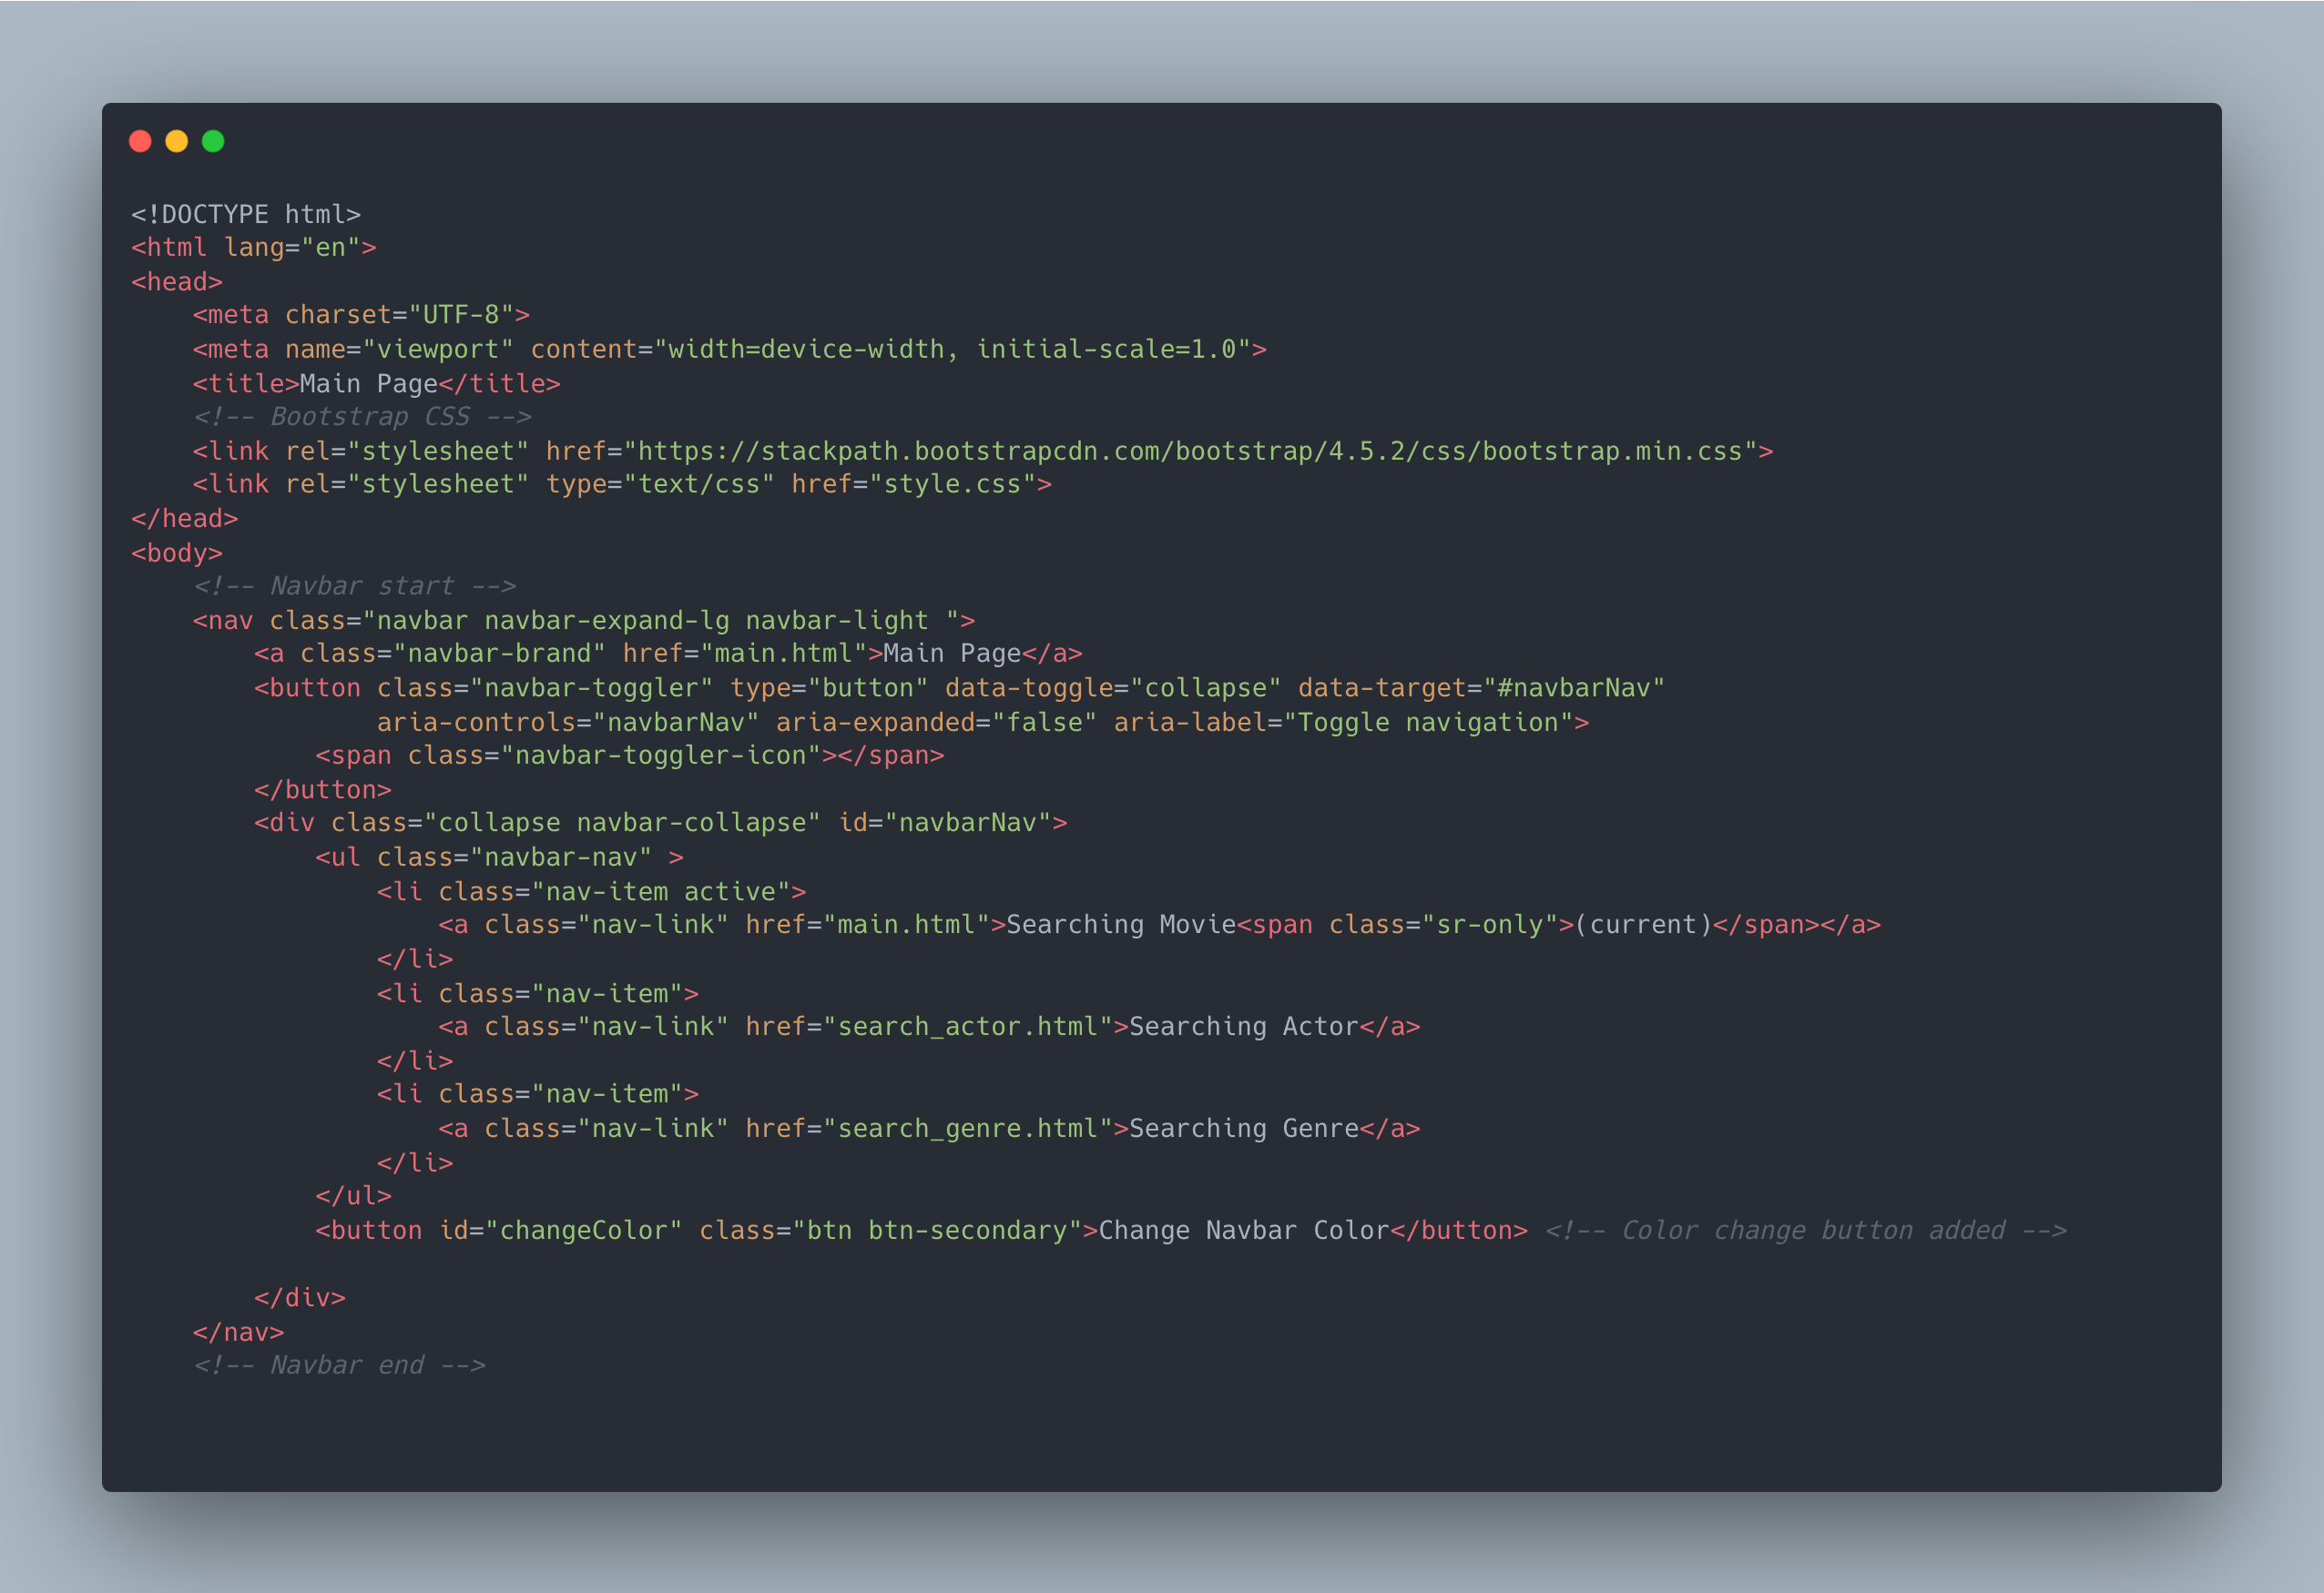
main.html
Notes:
You can see the overall interface through the code in main.html. I have constructed the navbar using Bootstrap and Popper, enabling navigation through search. Additionally, I have created a search bar to allow for searching movies.

Slide 9
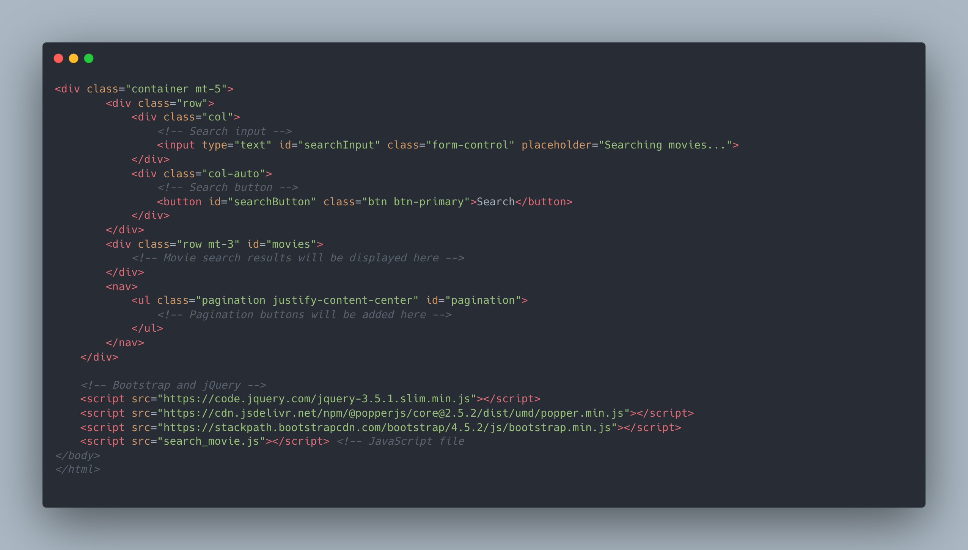
main.html
Notes:
This section has been designed to allocate space for pagination to be displayed.

Slide 10
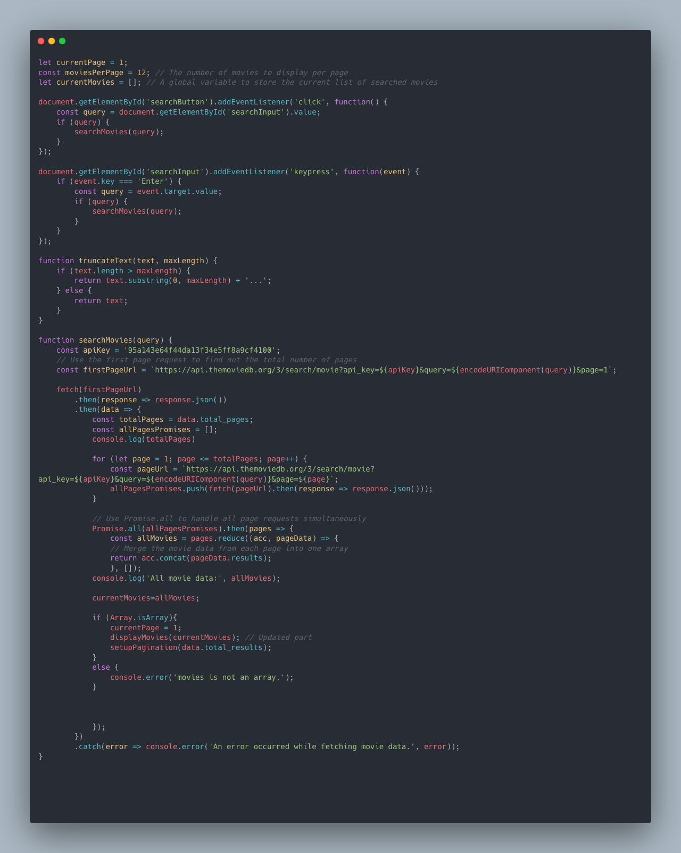
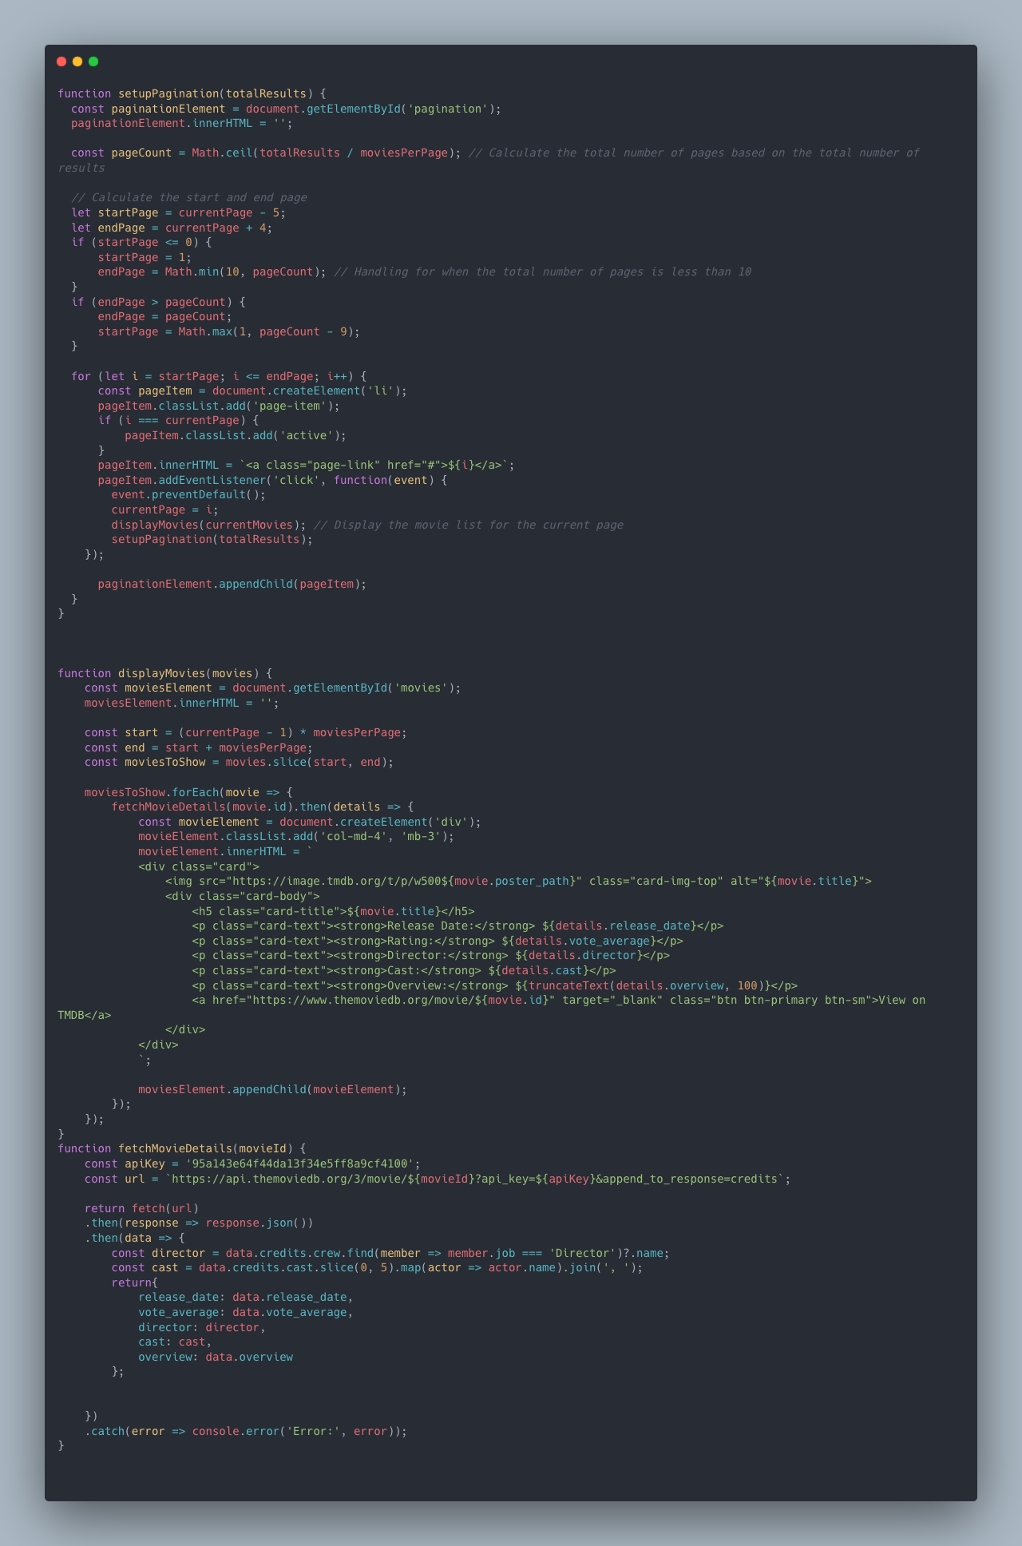
search_movie.js (it’s main code of js code)
Notes:
First, an array named currentMovies is declared as a global variable to hold the movie search results. A global variable named moviesPerPage is declared to display 12 movies per page. Event listeners for the search button and enter key were created to execute the search function. The truncateText function is designed to set a maximum length for movie descriptions, considering that each movie has a different description length. The searchMovie function is a function that uses an API to fetch movies by their titles. It also uses asynchronous functions to retrieve all movie data and save it in the name array. The setPagination function proceeds with pagination based on the number of movies searched. Firstly, the fetchMoviesDetails function fetches the details of the searched movies and returns them. This function is used in the displayMovies function to display the movie posters and details using card elements on the screen.

Slide 11
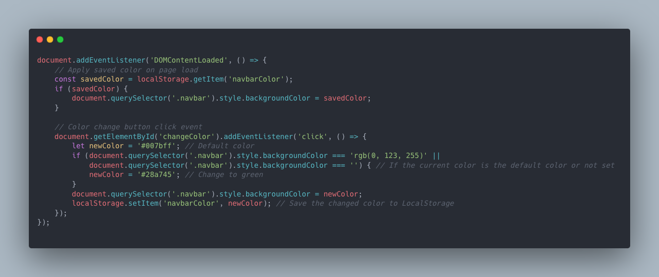
search_movie.js (it’s main code of js code)
Notes:
Finally, this is a function that allows changing the theme of the navbar using local storage. It has been implemented using EventListener and DOMContentLoaded.

Slide 12
Main implementation problems you had facing
The main implementation challenge faced
When implementing pagination in JavaScript, the main issue encountered was that not all movie results were fetched, but only the first 20 movies displayed on the initial screen when searching on TMDB were retrieved.
To resolve this, asynchronous programming was employed to fetch all movies at once, which then allowed the successful completion of the pagination.
Throughout this resolution process, `console.log` was utilized to debug and identify the problem within the console.

Slide 13
Conclusion
I had the opportunity to create a movie search website using the TMDB API, which was a great chance to build a site using HTML and JavaScript.
Additionally, solving the problems encountered during the project seemed to contribute to the growth of my knowledge and experience in WWW technology.
I plan not to stop with the website created for the final project but to add more features and provide a better service through an enhanced website.

